Slide 1
THE TRANSMISSION MEDIA

Slide 2
TRANSMISSION MEDIA
The Transmission Media
Any material, substance which can propagate the energy waves
Any material, substance or resource through which the communication signal can be transmitted.

Slide 3
TRANSMISSION MEDIA
Guided Transmission Media
A communication medium which has its tangible or viewable physical existence
Wireless Transmission media (unguided)
A communication medium which does not has a tangible physical existence but the data is transmitted in the form of wave/rays

Slide 4
Design Factors for Transmission Media
Bandwidth:
All other factors remaining constant, the greater the band-width of a signal, the higher the data rate that can be achieved.
Transmission impairments.
Limit the distance a signal can travel.
Interference:
Competing signals in overlapping frequency bands can distort or wipe out a signal.
Number of receivers:
Each attachment introduces some attenuation and distortion, limiting distance and/or data rate.

Slide 5
Electromagnetic Spectrum for Transmission Media

Slide 6
Guided Transmission Media
Transmission capacity depends on the distance and on whether the medium is point-to-point or multipoint
Examples
twisted pair wires
coaxial cables
optical fiber

Slide 7
Twisted Pair Wires
Consists of two insulated copper wires arranged in a regular spiral pattern to minimize the electromagnetic interference between adjacent pairs
Often used at customer facilities and also over distances to carry voice as well as data communications
Low frequency transmission medium

Slide 8
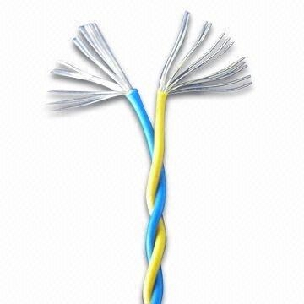
Twisted Pair Wires

Slide 9
Twisted Pair Cable Classes
STP (shielded twisted pair)
the pair is wrapped with metallic foil or braid to insulate the pair from electromagnetic interference
UTP (unshielded twisted pair)
each wire is insulated with plastic wrap, but the pair is encased in an outer covering

Slide 10
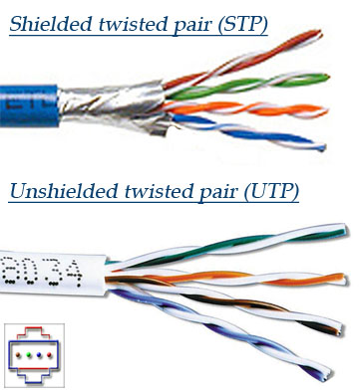
Twisted Pair Cable Classes

Slide 11
Ratings of Twisted Pair
Category 3 UTP
data rates of up to 16mbps are achievable
Category 5 UTP
data rates of up to 100mbps are achievable
more tightly twisted than Category 3 cables
more expensive, but better performance
Category 6
SELF
STP
More expensive,
harder to work with

Slide 12
Twisted Pair Advantages
Inexpensive
readily available
Flexible and light weight
Easy to work with and install
Cables may hold hundreds of pairs. Neighbor pairs typically have different twist lengths to reduce crosstalk.

Slide 13
Twisted Pair Disadvantages
Susceptibility to interference and noise
Attenuation problem
For analog, repeaters needed every 5-6km
For digital, repeaters needed every 2-3km
Relatively low bandwidth (3000Hz)

Slide 14
Coaxial Cable (or Coax)
Used for cable television, LANs, telephony
Has an inner conductor surrounded by a braided mesh
Both conductors share a common center axial, hence the term “co-axial”

Slide 15
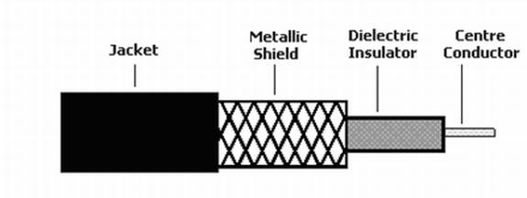
Coaxial Cable (or Coax)

Slide 16
Coax Layers
outer jacket
(polyethylene)
shield (braided wire)
insulating material
copper or aluminum
conductor

Slide 17
Coax Cable Classes
Thinnet cable (10Base2)
Thicknet cable (10Base5)

Slide 18
Thinnet
Thinnet coaxial cable is connected using special connectors and requires to be terminated at each end using a 50ohm resistor.
10Base2 stands for:
Data Transmission Rate of 10Mbps, i.e. 10
Uses baseband transmission, i.e. Base
Used in Ethernet networks it has a maximum cable length of 185 metres, i.e. the 2 for approximately 200 metres

Slide 19
Thicknet
Thicknet is similar in construction to Thinnet, however, there is an additional layer of aluminum insulation and copper braid. This means that the cable is more rigid and reliable and can be used for longer runs.
The thicker the copper core, the further the cable can carry signals. Thicknet is sometimes used as a backbone to connect several smaller Thinnet based networks.
10base5 stands for:
Data Transmission Rate of 10Mbps, i.e. 10
Uses base band transmission, i.e. Base
Used in Ethernet networks it has a maximum cable length of 500 meters, i.e. the 5 is for 500 meters

Slide 20
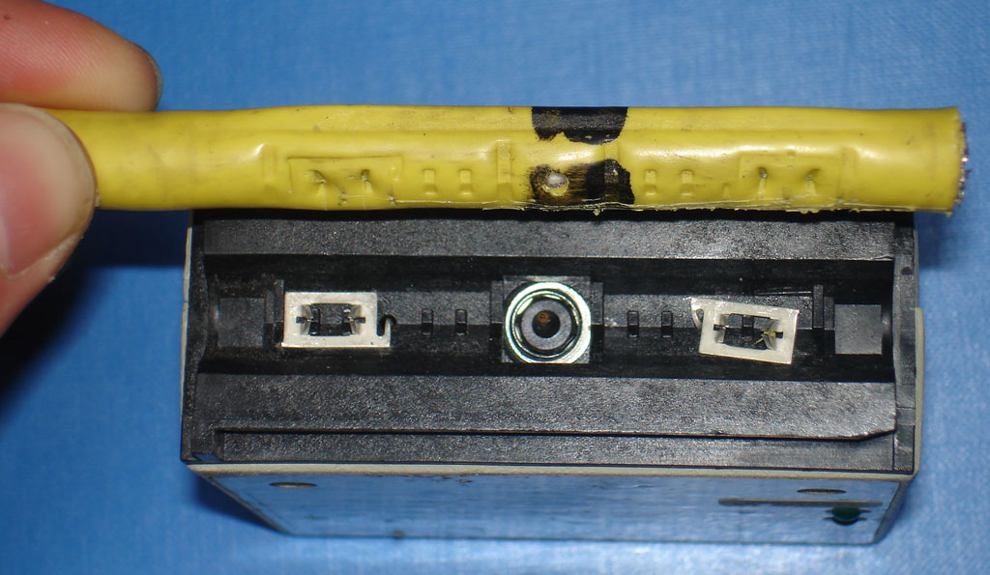
Thicknet
Thicknet is similar in construction to Thinnet, however, there is an additional layer of aluminum insulation and copper braid. This means that the cable is more rigid and reliable and can be used for longer runs.
The thicker the copper core, the further the cable can carry signals. Thicknet is sometimes used as a backbone to connect several smaller Thinnet based networks.
10base5 stands for:
Data Transmission Rate of 10Mbps, i.e. 10
Uses base band transmission, i.e. Base
Used in Ethernet networks it has a maximum cable length of 500 meters, i.e. the 5 is for 500 meters

Slide 21
Coax Advantages
Higher bandwidth
400 to 600Mhz
up to 10,800 voice conversations
Can be tapped easily (pros and cons)
Much less susceptible to interference than twisted pair

Slide 22
Coax Disadvantages
High attenuation rate makes it expensive over long distance
Bulky

Slide 23
Fiber Optic Cable
Relatively new transmission medium used by telephone companies in place of long-distance trunk lines
Also used by private companies in implementing local data communications networks
Require a light source with Injection Laser Diode (ILD) or Light-Emitting Diodes (LED)

Slide 24
Fiber Optic Layers
consists of three concentric sections
plastic jacket
glass or plastic
cladding
fiber core

Slide 25
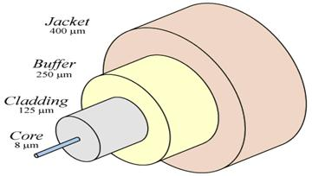
The Fiber Optics

Slide 26
Fiber Optic Types
multimode step-index fiber
the reflective walls of the fiber move the light pulses to the receiver
multimode graded-index fiber
acts to refract the light toward the center of the fiber by variations in the density
single mode fiber
the light is guided down the center of an extremely narrow core

Slide 27
Fiber Optic Signals
fiber optic multimode
step-index
fiber optic multimode
graded-index
fiber optic single mode

Slide 28
Fiber Optic Cable Operation
Light source
Receiver
Total internal reflection

Slide 29
Optical Fiber Advantages
Greater capacity (bandwidth of up to 2 Gbps)
smaller size and lighter weight
lower attenuation
immunity to environmental interference
highly secure due to tap difficulty and lack of signal radiation

Slide 30
Fiber Optic Disadvantages
expensive over short distance
requires highly skilled installers
adding additional nodes is difficult

Slide 31
Wireless (Unguided Media) Transmission
transmission and reception are achieved by means of an antenna
directional
transmitting antenna puts out focused beam
transmitter and receiver must be aligned
omnidirectional
signal spreads out in all directions
can be received by many antennas

Slide 32
Wireless Examples
terrestrial microwave
satellite microwave
broadcast radio
infrared

Slide 33
Terrestrial Microwave
used for long-distance telephone service
uses radio frequency spectrum, from 2 to 40 Ghz
parabolic dish transmitter, mounted high
used by common carriers as well as private networks
requires unobstructed line of sight between source and receiver
curvature of the earth requires stations (repeaters) ~30 miles apart

Slide 34
Satellite Microwave Applications
Television distribution
Long-distance telephone transmission
Private business networks

Slide 35
Microwave Transmission Disadvantages
line of sight requirement
expensive towers and repeaters
subject to interference such as passing airplanes and rain

Slide 36
Satellite Microwave Transmission
a microwave relay station in space
can relay signals over long distances
geostationary satellites
remain above the equator at a height of 22,300 miles (geosynchronous orbit)
travel around the earth in exactly the time the earth takes to rotate

Slide 37
Satellite Transmission Links
earth stations communicate by sending signals to the satellite on an uplink
the satellite then repeats those signals on a downlink
the broadcast nature of the downlink makes it attractive for services such as the distribution of television programming

Slide 38
Satellite Transmission Process
satellite
transponder
dish
dish
22,300 miles
uplink station
downlink station

Slide 39
Satellite Transmission Applications
television distribution
a network provides programming from a central location
direct broadcast satellite (DBS)
long-distance telephone transmission
high-usage international trunks
private business networks

Slide 40
Principal Satellite Transmission Bands
C band: 4(downlink) - 6(uplink) GHz
the first to be designated
Ku band: 12(downlink) -14(uplink) GHz
rain interference is the major problem
Ka band: 19(downlink) - 29(uplink) GHz
equipment needed to use the band is still very expensive

Slide 41
Fiber vs Satellite

Slide 42
Radio
radio is omni directional and microwave is directional
Radio is a general term often used to encompass frequencies in the range 3 kHz to 300 GHz.
Mobile telephony occupies several frequency bands just under 1 GHz.

Slide 43
Infrared
Uses transmitters/receivers (transceivers) that modulate noncoherent infrared light.
Transceivers must be within line of sight of each other (directly or via reflection ).
Unlike microwaves, infrared does not penetrate walls.

